Slide 1
Lists / Tuples / Dictionary / Sets with Methods
M.Tech-DS_ML
ITP: Project Presentation
Team 7
-Ranjith
-Rajesh
-Yashwaswi
-Praveen
-Rahul

Slide 2
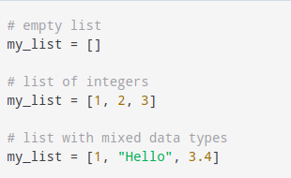

Lists
List is an indexed, mutable and iterable data type in python that is stored in primary memory. They are numerically indexed starting from 0. Lists can be heterogeous or homogenous and can be single or multi-dimensional. It supports various kinds of powerful operations like inplace reversing(via negative indexing), slicing (returning a particular subset of the of the list) and list comprehension (generating a list based on certain conditions and inputs). A list data type also has attributes like len, min, max, etc. A list can also be nested.
How to create a list?
In Python, a list is created by placing all the items (elements) inside square brackets [], separated by commas.It can have any number of items and they may be of different types (integer, float, string etc.).
How to access elements from a list?
We can use the index operator [] to access an item in a list. In Python, indices start at 0. So, a list having 5 elements will have an index from 0 to 4.Trying to access indexes other than these will raise an IndexError. The index must be an integer. We can't use float or other types, this will result in TypeError.Nested lists are accessed using nested indexing.
A list can also have another list as an item. This is called a nested list.

Slide 3
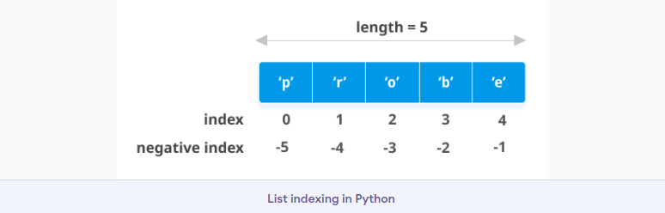
Lists
Negative indexing
Python allows negative indexing for its sequences. The index of -1 refers to the last item, -2 to the second last item and so on.
How to slice lists in Python?
We can access a range of items in a list by using the slicing operator :(colon).Slicing can be best visualized by considering the index to be between the elements as shown below. So if we want to access a range, we need two indices that will slice that portion from the list.
How to change or add elements to a list?
Lists are mutable, meaning their elements can be changed unlike string or tuple.We can use the assignment operator (=) to change an item or a range of items.We can add one item to a list using the append() method or add several items using extend() method. We can also use + operator to combine two lists. This is also called concatenation.The * operator repeats a list for the given number of times.Furthermore, we can insert one item at a desired location by using the method insert() or insert multiple items by squeezing it into an empty slice of a list.

Slide 4
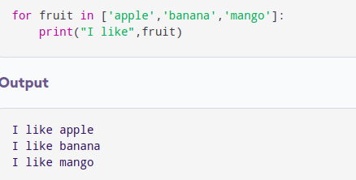
Lists
How to delete or remove elements from a list?
We can delete one or more items from a list using the keyword del. It can even delete the list entirely.We can use remove() method to remove the given item or pop() method to remove an item at the given index.The pop() method removes and returns the last item if the index is not provided. This helps us implement lists as stacks (first in, last out data structure).We can also use the clear() method to empty a list.
Python List Methods
Methods that are available with list objects in Python programming are tabulated below.They are accessed as list.method().
Python List Methods
append() - Add an element to the end of the list
extend() - Add all elements of a list to the another list
insert() - Insert an item at the defined index
remove() - Removes an item from the list
pop() - Removes and returns an element at the given index
clear() - Removes all items from the list
index() - Returns the index of the first matched item
count() - Returns the count of the number of items passed as an argument
sort() - Sort items in a list in ascending order
reverse() - Reverse the order of items in the list
copy() - Returns a shallow copy of the list
Iterating Through a List
Using a for loop we can iterate through each item in a list.

Slide 5
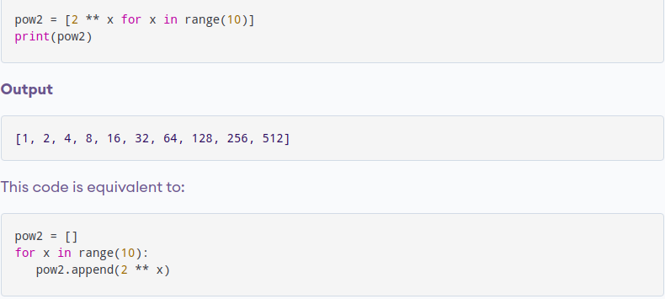
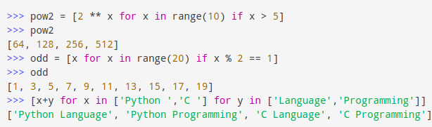
List Comprehension: Performing complex operations
List comprehension is an elegant and concise way to create a new list from an existing list in Python.A list comprehension consists of an expression followed by for statement inside square brackets.Here is an example to make a list with each item being increasing power of 2.
A list comprehension can optionally contain more for or if statements. An optional if statement can filter out items for the new list. Here are some examples.

Slide 6
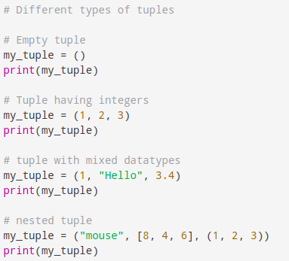
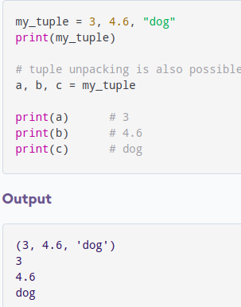
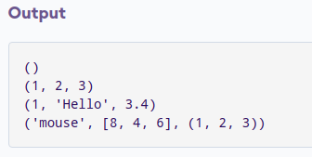
Tuple
A tuple in Python is similar to a list. The difference between the two is that we cannot change the elements of a tuple once it is assigned whereas we can change the elements of a list.
Creating a Tuple
A tuple is created by placing all the items (elements) inside parentheses (), separated by commas. The parentheses are optional, however, it is a good practice to use them.A tuple can have any number of items and they may be of different types (integer, float, list, string, etc.).
A tuple can also be created without using parentheses. This is known as tuple packing.

Slide 7
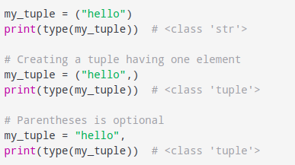
Tuple
Creating a tuple with one element:
Having one element within parentheses is not enough. We will need a trailing comma to indicate that it is, in fact, a tuple.
Indexing & Slicing:
Indexing and slicing concepts do not differ from List
Deleting a Tuple
As discussed above, we cannot change the elements in a tuple. It means that we cannot delete or remove items from a tuple.Deleting a tuple entirely, however, is possible using the keyword del.

Slide 8
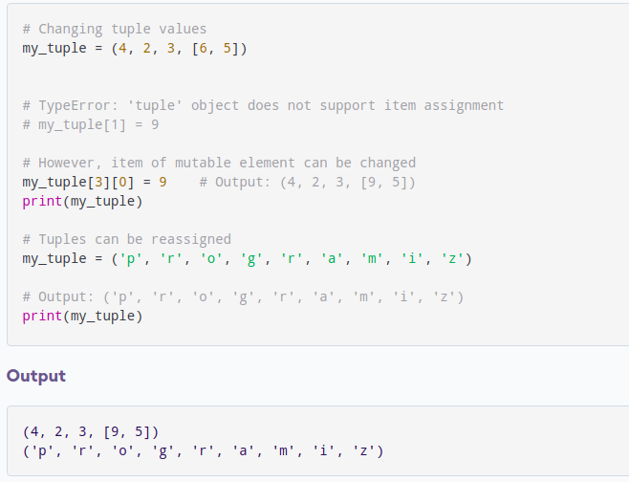
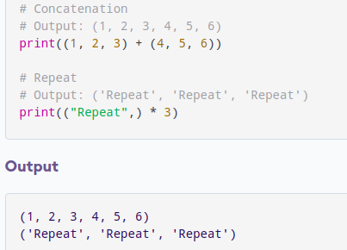
Changing a Tuple
Unlike lists, tuples are immutable.This means that elements of a tuple cannot be changed once they have been assigned. But, if the element is itself a mutable data type like list, its nested items can be changed.We can also assign a tuple to different values (reassignment).
Tuple Methods
List and tuple have similar methods.The difference is that methods that add items or remove items are not available with tuple
We can use + operator to combine two tuples. This is called concatenation.We can also repeat the elements in a tuple for a given number of times using the * operator.Both + and * operations result in a new tuple.

Slide 9
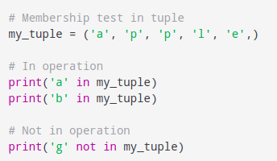
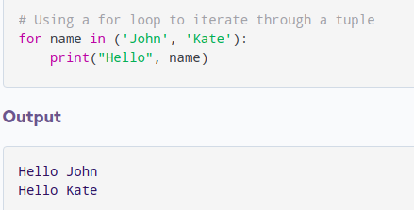
Other Tuple Operations
1.Tuple Membership Test
We can test if an item exists in a tuple or not, using the keyword in.
Advantages of Tuple over List
Since tuples are quite similar to lists, both of them are used in similar situations. However, there are certain advantages of implementing a tuple over a list. Below listed are some of the main advantages:
We generally use tuples for heterogeneous (different) data types and lists for homogeneous (similar) data types.
Since tuples are immutable, iterating through a tuple is faster than with list. So there is a slight performance boost.
Tuples that contain immutable elements can be used as a key for a dictionary. With lists, this is not possible.
If you have data that doesn't change, implementing it as tuple will guarantee that it remains write-protected.
2.Iterating Through a Tuple
We can use a for loop to iterate through each item in a tuple.

Slide 10
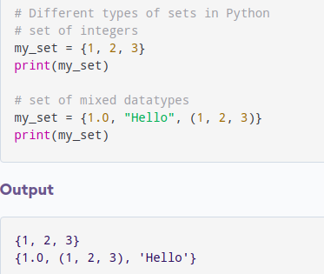
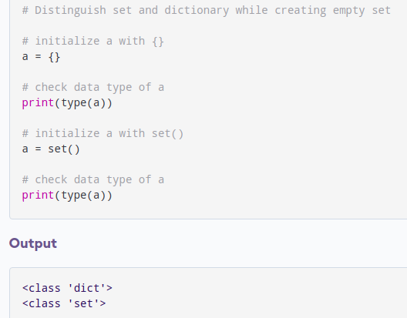
Python Sets
A set is an unordered collection of items. Every set element is unique (no duplicates) and must be immutable (cannot be changed).However, a set itself is mutable. We can add or remove items from it.Sets can also be used to perform mathematical set operations like union, intersection, symmetric difference, etc.
Creating Python Sets
A set is created by placing all the items (elements) inside curly braces {}, separated by comma, or by using the built-in set() function.It can have any number of items and they may be of different types (integer, float, tuple, string etc.). But a set cannot have mutable elements like lists, sets or dictionaries as its elements.
Empty curly braces {} will make an empty dictionary in Python. To make a set without any elements, we use the set() function without any argument.

Slide 11
Functions in a set
Modifying a set in Python
Sets are mutable. However, since they are unordered, indexing has no meaning.We cannot access or change an element of a set using indexing or slicing. Set data type does not support it.We can add a single element using the add() method, and multiple elements using the update() method. The update() method can take tuples, lists, strings or other sets as its argument. In all cases, duplicates are avoided.
Removing elements from a set
Similarly, we can remove and return an item using the pop() method.Since set is an unordered data type, there is no way of determining which item will be popped. It is completely arbitrary.We can also remove all the items from a set using the clear() method.A particular item can be removed from a set using the methods discard() and remove().The only difference between the two is that the discard() function leaves a set unchanged if the element is not present in the set.
Other Python Set Methods
add() Adds an element to the set
clear() Removes all elements from the set
copy() Returns a copy of the set
difference() Returns the difference of two or more sets as a new set
difference_update() Removes all elements of another set from this set
discard() Removes an element from the set if it is a member. (Do nothing if the element is not in set)
intersection() Returns the intersection of two sets as a new set
intersection_update() Updates the set with the intersection of itself and another
isdisjoint() Returns True if two sets have a null intersection
issubset() Returns True if another set contains this set
issuperset() Returns True if this set contains another set
pop() Removes and returns an arbitrary set element. Raises KeyError if the set is empty
remove() Removes an element from the set. If the element is not a member, raises a KeyError
symmetric_difference() Returns the symmetric difference of two sets as a new set
symmetric_difference_update() Updates a set with the symmetric difference of itself and another
union() Returns the union of sets in a new set
update() Updates the set with the union of itself and others

Slide 12
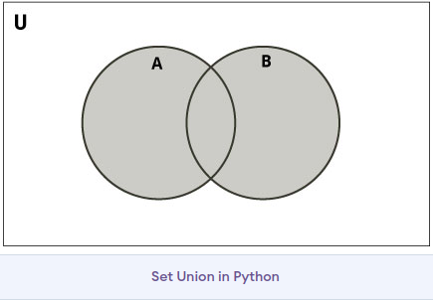
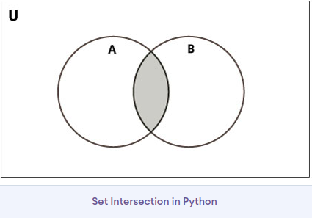
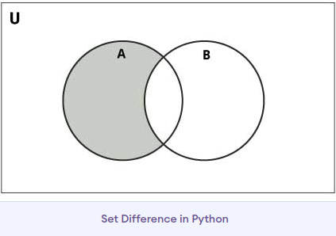
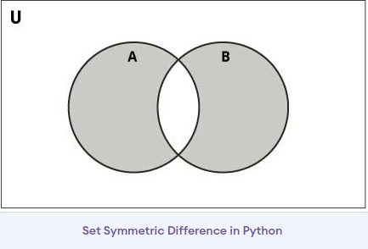
Python Set Operations
Sets can be used to carry out mathematical set operations like union, intersection, difference and symmetric difference. We can do this with operators or methods.
Union of A and B is a set of all elements from both sets.Union is performed using | operator. Same can be accomplished using the union() method.
Intersection of A and B is a set of elements that are common in both the sets.Intersection is performed using & operator.
Difference of the set B from set A(A - B) is a set of elements that are only in A but not in B. Similarly, B - A is a set of elements in B but not in A.Difference is performed using - operator.
Symmetric Difference of A and B is a set of elements in A and B but not in both (excluding the intersection).Symmetric difference is performed using ^ operator. Same can be accomplished using the method symmetric_difference().

Slide 13
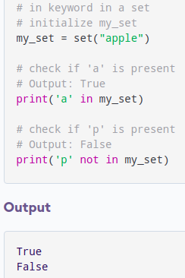
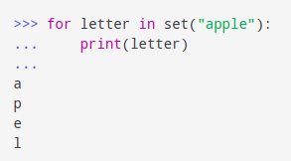
Set Operations
Set Membership Test
We can test if an item exists in a set or not, using the in keyword.
Built-in Functions with Set
Built-in functions like all(), any(), enumerate(), len(), max(), min(), sorted(), sum() etc. are commonly used with sets to perform different tasks.
all() Returns True if all elements of the set are true (or if the set is empty).
any() Returns True if any element of the set is true. If the set is empty, returns False.
enumerate() Returns an enumerate object. It contains the index and value for all the items of the set as a pair.
len() Returns the length (the number of items) in the set.
max() Returns the largest item in the set.
min() Returns the smallest item in the set.
sorted() Returns a new sorted list from elements in the set(does not sort the set itself).
sum() Returns the sum of all elements in the set.
Iterating Through a Set
We can iterate through each item in a set using a for loop.

Slide 14
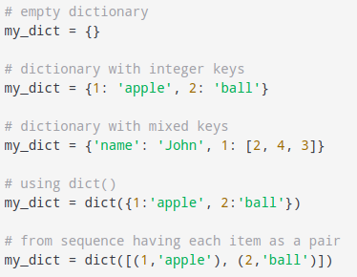
Python Dictionary
Python dictionary is an unordered collection of items.Each item of a dictionary has a key/value pair.Dictionaries are optimized to retrieve values when key is known.
Creating Python Dictionary
Creating a dictionary is as simple as placing items inside curly braces {} separated by commasAn item has a key and a corresponding value that is expressed as a pair (key: value).While the values can be of any data type and can repeat, keys must be of immutable type (string, number or tuple with immutable elements) and must be unique.
Accessing Elements from Dictionary
While indexing is used with other data types to access values, a dictionary uses keys. Keys can be used either inside square brackets [] or with the get() method.
If we use the square brackets [], KeyError is raised in case a key is not found in the dictionary. On the other hand, the get() method returns None if the key is not found.

Slide 15
Changing,Adding and Deleting Dictionary elements
Dictionaries are mutable. We can add new items or change the value of existing items using an assignment operator.If the key is already present, then the existing value gets updated. In case the key is not present, a new (key: value) pair is added to the dictionary.
Removing elements from Dictionary
We can remove a particular item in a dictionary by using the pop() method. This method removes an item with the provided key and returns the value.The popitem() method can be used to remove and return an arbitrary (key, value) item pair from the dictionary. All the items can be removed at once, using the clear() method.We can also use the del keyword to remove individual items or the entire dictionary itself.
Python Dictionary Methods
clear() Removes all items from the dictionary.
copy() Returns a shallow copy of the dictionary.
fromkeys(seq[, v]) Returns a new dictionary with keys from seq and value equal to v (defaults to None).
get(key[,d]) Returns the value of the key. If the key does not exist, returns d (defaults to None).
items() Return a new object of the dictionary's items in (key, value) format.
keys() Returns a new object of the dictionary's keys.
pop(key[,d]) Removes the item with the key and returns its value or d if key is not found. If d is not provided and the key is not found, it raises KeyError.
popitem() Removes and returns an arbitrary item (key, value). Raises KeyError if the dictionary is empty.
setdefault(key[,d]) Returns the corresponding value if the key is in the dictionary. If not, inserts the key with a value of d and returns d (defaults to None).
update([other]) Updates the dictionary with the key/value pairs from other, overwriting existing keys.
values() Returns a new object of the dictionary's values

Slide 16
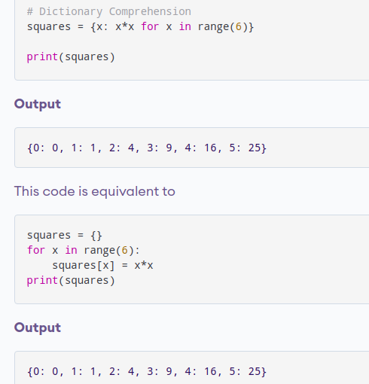
Python Dictionary Comprehension
Dictionary comprehension is an elegant and concise way to create a new dictionary from an iterable in Python.Dictionary comprehension consists of an expression pair (key: value) followed by a for statement inside curly braces {}.
Other Dictionary Operations
Dictionary Membership Test
We can test if a key is in a dictionary or not using the keyword in. Notice that the membership test is only for the keys and not for the values.
Iterating Through a Dictionary
We can iterate through each key in a dictionary using a for loop.
A dictionary comprehension can optionally contain more for or if statements. An optional if statement can filter out items to form the new dictionary.

